Slide 1
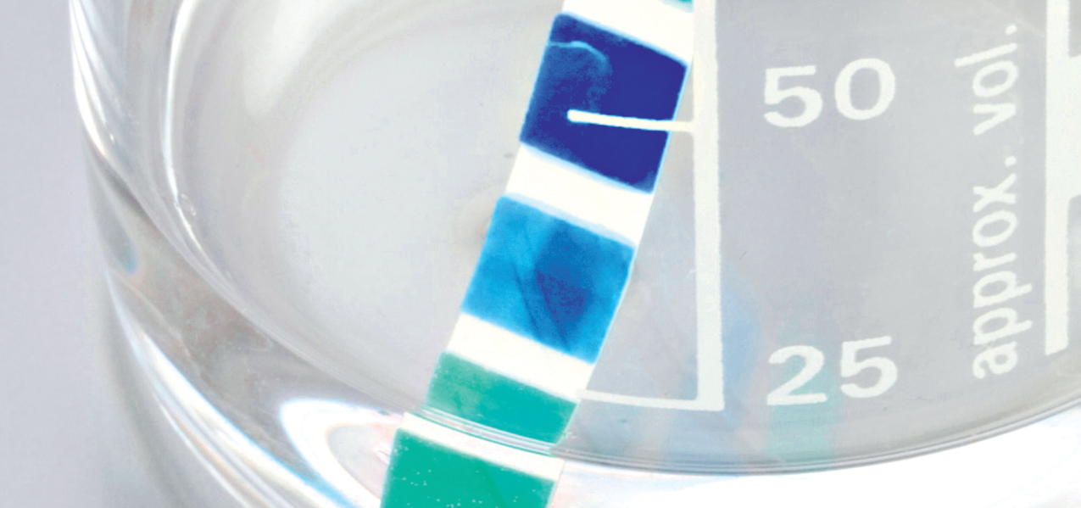
Chapter 7: Reactions in aqueous solutions

Slide 2
Solute + Solvent = Solution
Solubility is defined as the mass of solute that can dissolve 100g of water.
Saturated means that it is the maximum amount of solute that can dissolve in the solvent at that temperature.
Unsaturated means more solute can dissolve in the solvent at that temperature.
Supersaturated means that there is more solute dissolved in the solvent than would normally allow and this is often carried out by heating the solution and cooling slowly, but there the possibility of the solute recrystallising.

Slide 3

Aqueous solutions of ionic compounds
Can be classified as:
Soluble
> 10g solute L⁻¹
Insoluble
less than 1 gL⁻¹
Sparingly soluble
Between 1gL⁻¹ to 10gL⁻¹

Slide 4
Electrolytes
Electrolytes such as strong bases fully dissociate and are strong electrolytes, and their ions fully dissolved in water, eg NaOH.
Electrolytes such as strong acids fully ionise and are strong electrolytes, and their ions fully dissolve in water, eg HCl.
Weak electrolytes are weak bases and acids which only partly dissolve/ionise in water and are normally found in the molecular species. Eg ethanoic acid and ammonia.
Non electrolytes do not produce ions in water and exist as free and independent molecules eg glucose.
Electrical conductivity is dependent of the concentration of dissolved ions, the greater the concentration the greater the number of mobile charge carriers.

Slide 5
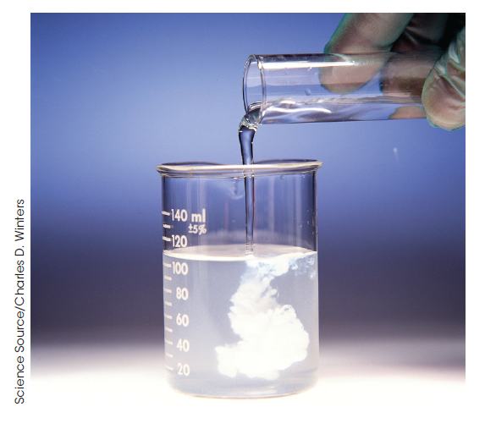
Precipitation reactions
A precipitate is a solid produced by the reaction between two clear solutions.
.

Slide 6
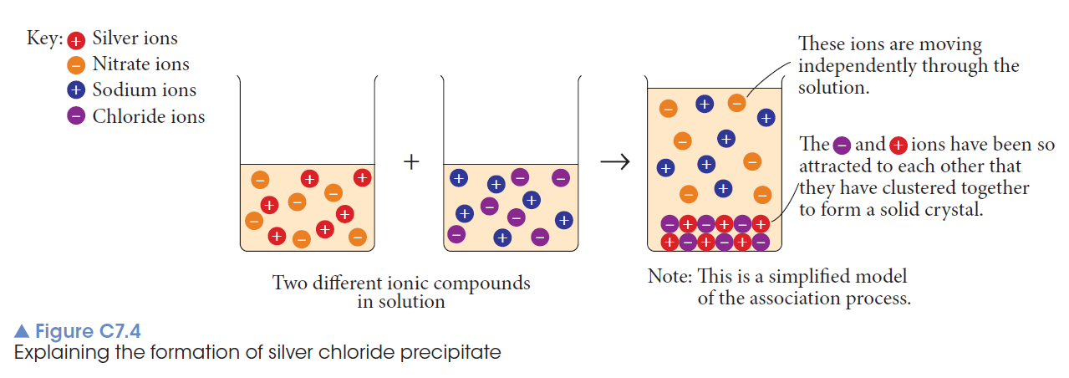
Sodium chloride is added to a silver nitrate solution.

Slide 7
Complete ionic equation
Na⁺(aq) + Cl⁻(aq) + Ag⁺(aq) + NO₃⁻(aq) → AgCl(s) + Na ⁺(aq) + NO₃⁻ (aq)
Shows all ions present
Net ionic equation
Ag⁺(aq) + Cl⁻ (aq) → AgCl(s)
The spectator ions Na⁺ and NO₃⁻ not shown.

Slide 8
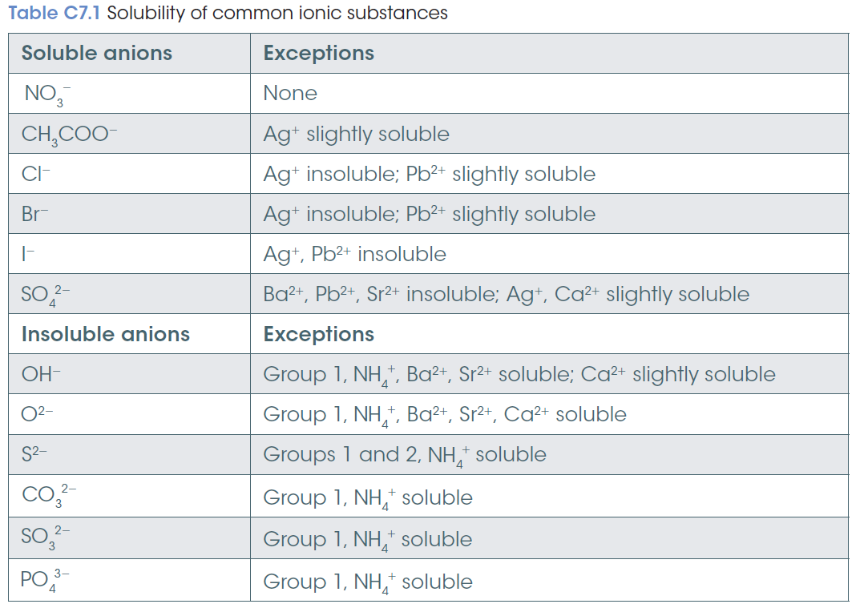

Slide 9
Determining concentration
The concentration of a solution is the amount of solute present in a specified amount of solution.
% w/w, % v/w, % w/v and ppm

Slide 10
Molarity
The measure of concentration in terms of moles is called molarity.
The molarity of a solution is defined as the number of moles of solute per litre of solution.
c = n/V
Concentration (mol L⁻¹)
= number of moles of solute (mol)
volume of solution (L)

Slide 11
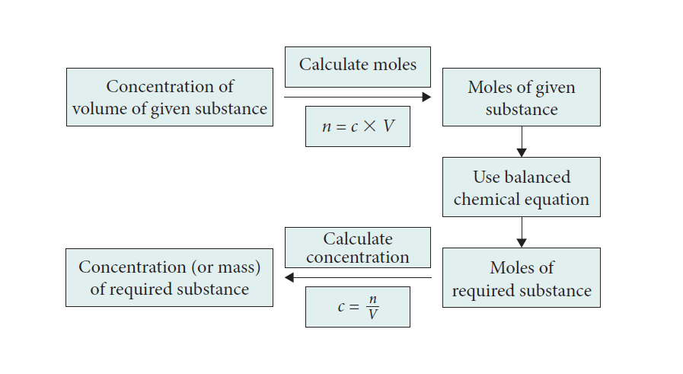

Slide 12
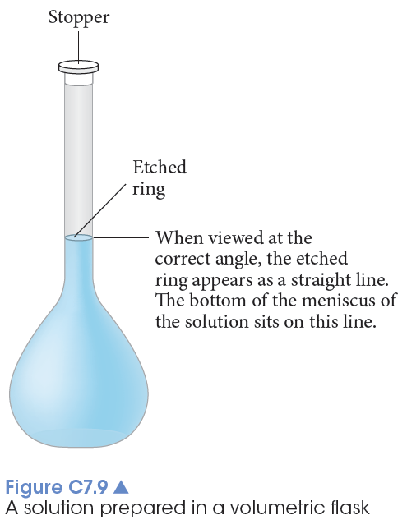
Laboratory preparation of a solution
Weigh the solute and transferred to a volumetric flask.
Rinse the solute’s beaker with distilled water and transfer to the volumetric flask.
Dissolve the solute with distilled water and then make up to the calibration mark.
The stopper is placed in the flask, which is inverted several times to ensure through mixing of the solution.

Slide 13
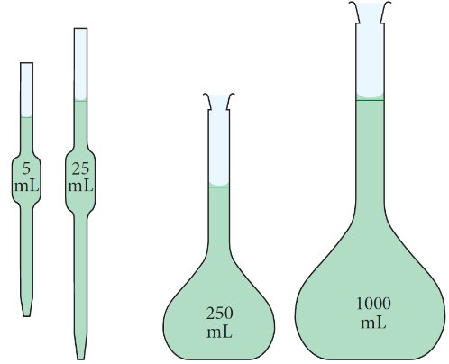
Dilutions
the process of adding water to a solution to make it less concentrated
Dilution procedure:
Use a pipette to measure a definite volume of a solution of known concentration.
Transfer this volume to a volumetric flask.
Add sufficient water to the volumetric flask to make up the solution to the calibration mark.

Slide 14
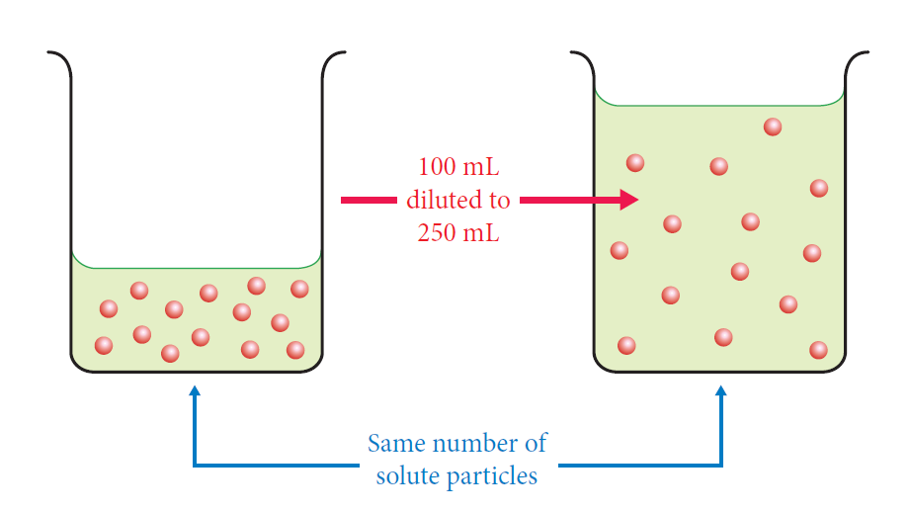
To calculate the concentration of the diluted solution, we use the fact that the number of moles (particles) in the diluted solution is the same as in the original volume of solution.

Slide 15
Calculations
c₁V₁ = c₂V₂
where c₁ and c₂ are the initial and final concentrations of the solution in the same units.
V₁ and V₂ are the initial and final volumes of the solution, in the same units.

Slide 16
Acids and bases
Arrhenius Theory
An acid
produces hydrogen ions, H⁺, in aqueous solution.
hydronium ions, H₃O⁺
A base
either contains the oxide O²⁻ or hydroxide ion OH⁻ or produces hydroxide ion in aqueous solution.
A soluble base is called an alkali.

Slide 17
Brønsted–Lowry
As more was learnt about acids and bases, the Brønsted–Lowry definitions were developed.
An acid is a substance that donates one or more protons or hydrogen ions (H⁺).
A base is a substance that accepts one or more protons.
Usually acids donate protons that are accepted by a base so they occur together.
Notes:
Show the difference between the common definition of a base as ‘something that produces hydroxide ions in water’. This is true for many bases but not true of all bases.

Slide 18
Common properties of acids include:
a sour taste
sting or burn the skin
conduct electricity in solution
turn blue litmus red
Common properties of bases include:
a slippery feel in aqueous solution
a bitter taste
conduct electricity in solution
turn red litmus blue

Slide 19
Amphoteric oxide
Not all oxides are basic.
Most oxides formed between a non-metal and oxygen (for example CO₂ and SO₃) are acidic or
Neutral.
Those formed between a metal and oxygen.
For example CaO and MgO are basic
or amphoteric (acting as either an acid or a base.)

Slide 20
Acid base reactions
Acid and bases react to form compounds called salts and water.
This neutralisation reaction can be written as
Acid + base → salt and water
eg HCl(aq) + NaOH(aq) → NaCl(aq) + H₂O(l)

Slide 21
Indicators and pH
Indicators can also provide information on the degree of acidity or alkalinity.
A more precise scale to measure the concentration of acid in a solution is called the pH scale.

Slide 22
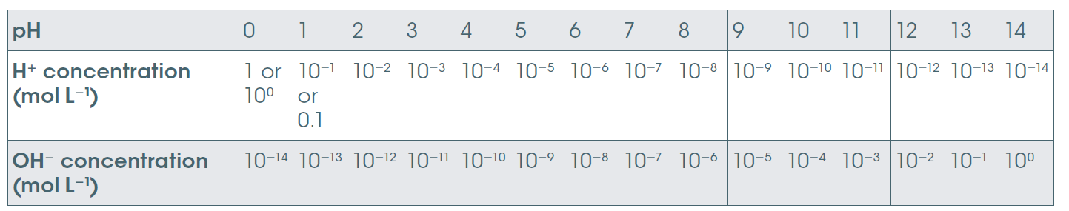
pH scale
The pH scale is based on the concentration of hydrogen ion in solution.
It provides a measure of the acidity or alkalinity.
pH < 7 acidic, pH = 7 neutral, pH > 7 basic
Note 1 pH unit change = 10 x change in concentration

Slide 23
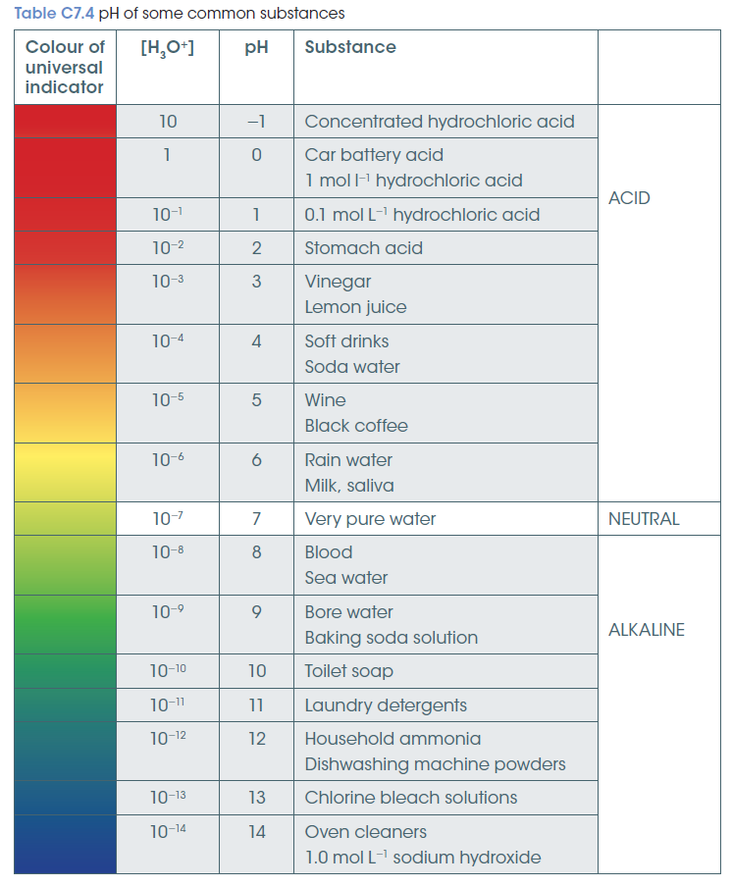
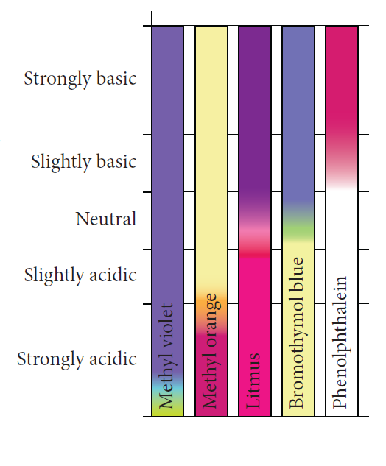
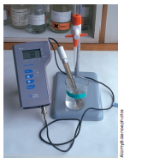
Measuring pH
pH measured by
Indicators change colour at various pH values
& pH meters.

Slide 24
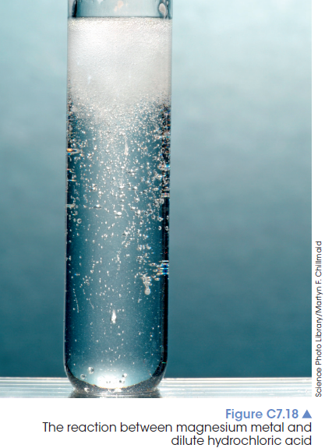
Reactions of acids
Acid + metal → salt + hydrogen gas
2HCl(aq) + Mg(s) → MgCl₂(aq) + H₂(g)

Slide 25
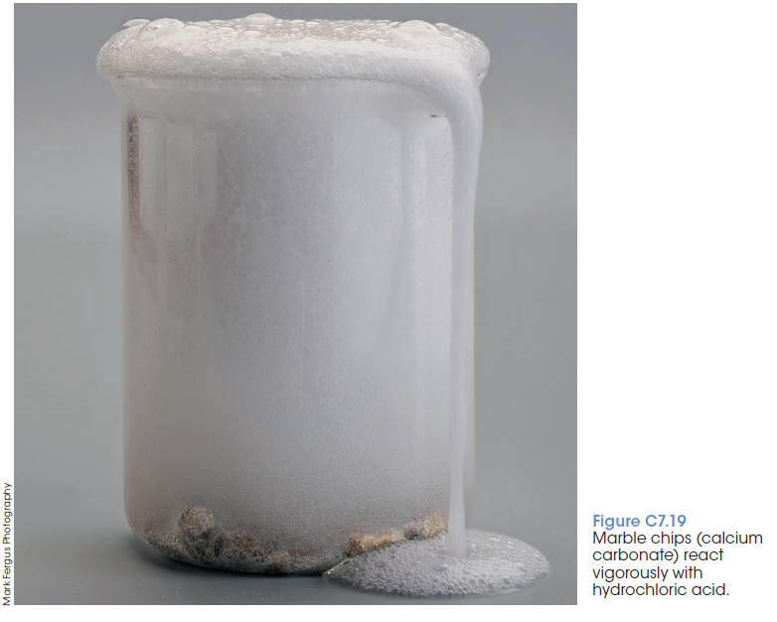
Acid + carbonate →
salt + carbon dioxide + water
2HCl(aq) + CaCO₃(s) → CaCl₂(aq) + H₂O(l) + CO₂(g)

Slide 26
Acid + hydrogen carbonate →
salt + carbon dioxide + water
HCl(aq) + NaHCO₃(s) → NaCl(aq) + H₂O(l) + CO₂(g)

Slide 27
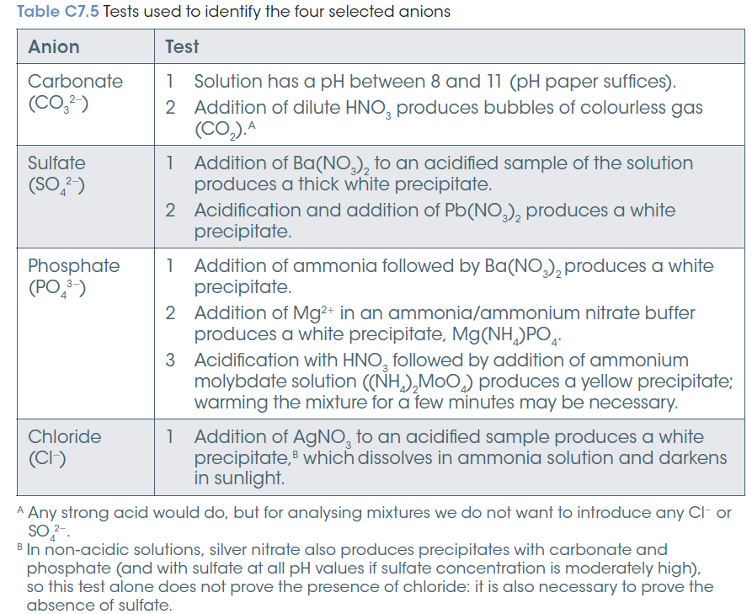
Identifying unknown ions in solution

Slide 28
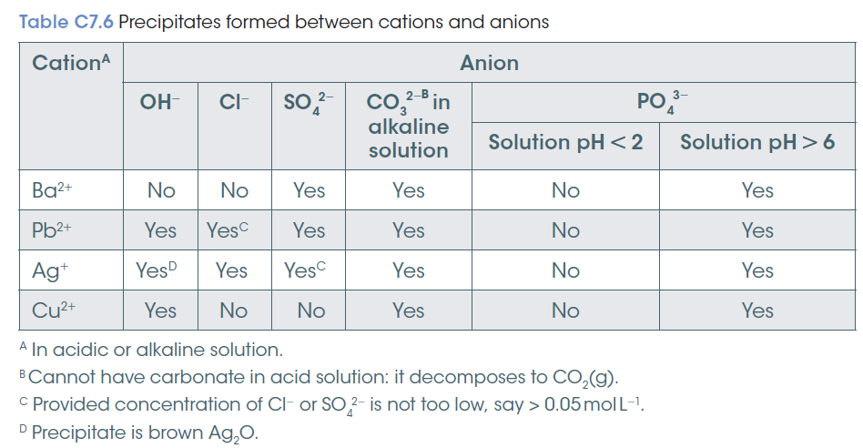

Slide 29
